Slide 1
WELCOME TO THE WORLD OF GIT

Slide 2
GIT OPERATION PART II -
THE TRUTH IS OUT THERE....
LINK FOR OUR SLIDE DECK https://bit.ly/git-2020-part2-devopshift

Slide 3
ABOUT ME
Ex CEO , CTO and SVP Engineering for multiple Israeli startups with 25 Years experience in the world of Software architecture , IT and Management.
Founder & CEO of :
DevopShift Israel - Devops solutions & consulting
Founder & CEO of of DevopShift Vienna
Im also Acting as Head of Of Devops for JohnBryce - Israeli biggest computer academy.
Last but not least a Devops and Microservices design lecturer around the world (6200 Students in just the last 2.5 Years).
Linkedin profile:
http://bit.ly/yaniv_linkedin
EMAIL: yaniv@ynot.work

Slide 4
- GIT IGNORE -

Slide 5
GIT IGNORE
In many cases we’ll have a class of files that we don’t want Git to automatically add or even show us as being untracked. These are generally automatically generated files such as log files or files produced by our build system and even password files (dear god). In such cases, we can create a file listing patterns to match them named .gitignore.
Many systems and frameworks that we’ll use in the future will have files that are not meant to be tracked (Tmp , source etc…)

Slide 6
GIT IGNORE
Here is a simple example of .gitignore file
$ cat .gitignore
# means ignore any files ending in “.o” or “.z”
*.[gz]
# means ignore all files whose names end in the word log
*.log

Slide 7
GIT IGNORE
Here is a more detailed example of .gitignore file
# ignore all .a files
*.a
# but do track lib.a, even though we're ignoring .a files above
!lib.a
# only ignore the TODO file in the current directory, not subdir/TODO
/build
# ignore all files in any directory named build
build/
# ignore all .pdf files in the doc/ directory and any of its subdirectories
doc/**/*.pdf”
Check this link for more great already made examples: https://github.com/github/gitignore

Slide 8
- UNDOING THINGS -

Slide 9
GIT UNDO
At any stage, we may want to undo something. Here, we’ll review a few basic tools for undoing changes that we’ve made. Be careful, we can’t always undo some of these undos. This is one of the few areas in Git where we may lose some work if we do it wrong. One of the common undos takes place when we commit too early and possibly forget to add some files, or we mess up with commit message. If we want to redo that commit, make the additional changes we forgot, stage them, and commit again using the --amend option:

Slide 10
GIT UNDO
This Command takes our staging area and uses it for the commit. If we’ve made no changes since our last commit (for instance, we run this command immediately after our previous commit), then our snapshot will look exactly the same, and all our change is in our commit message.`
FOLLOW THIS EXAMPLE
$ echo "line we added" > file.source
# stage file
$ git add file.source
$ git commit -m "First file added with a line"
NOW WE REMEMBER THAT THE COMMIT IS NOT FULL AND WE WISH TO UPDATE IT
$ echo "Adding a second line" >> file.source #STAGE THE FILE
$ git add file.source
$ git commit --amend -m
#ABOVE WILL ALLOW US TO FIX THE COMMIT MESSAGE AND REUSE SAME COMMIT

Slide 11
GIT UNDO
It’s important to understand that when you’re amending your last commit, you’re not so much fixing it as replacing it entirely with a new, improved commit that pushes the old commit out of the way and puts the new commit in its place. Effectively, it’s as if the previous commit never happened, and it won’t show up in your repository history.

Slide 12
GIT UNDO
Unstaging a Staged File
Let’s say we’ve update 50 files that we wanted to staged separately BUT mistakenly we used git add * which staged both files at the same time.
To undo this and Stage each file separately we need to follow this:

Slide 13
GIT UNDO
FOLLOW THIS EXAMPLE
$ git add *
$ git status
On branch master
Changes to be committed:
(use "git reset HEAD <file>..." to unstage)
renamed: README.md -> README
modified: CONTRIBUTING.md
UNDO IN NEXT SLIDE ----- >

Slide 14
GIT UNDO
UNDO ADD OF CONTRIBUTING FILE
$ git restore --staged CONTRIBUTING.md
$ git status
On branch master
Your branch is up to date with 'origin/master'.
Changes to be committed:
(use "git restore --staged <file>..." to unstage)
renamed: README.md -> README
Changes not staged for commit:
(use "git add <file>..." to update what will be committed)
(use "git restore <file>..." to discard changes in working directory)
modified: CONTRIBUTING.md

Slide 15
GIT UNDO
Unmodifying a Modified File
What if you realize that you don’t want to keep your changes to specific file?
Unmodifying
$ git status
Changes not staged for commit:
(use "git add <file>..." to update what will be committed)
(use "git restore <file>..." to discard changes in working directory)
modified: file.source
$ git restore file.source
On branch master
Your branch is up to date with 'origin/master'.
nothing to commit, working tree clean

Slide 16
GIT UNDO
When we like to keep the changes we’ve made to a file but still need to get it out of the way for now, we’ll go over stashing and branching in Git Branching; these are generally better ways to go.

Slide 17
- WORKING WITH REMOTES -

Slide 18
WORKING WITH REMOTES
To be able to collaborate on any Git project, we need to know how to manage our remote repositories. Remote repositories are versions of our project that are hosted on the Internet or network somewhere. we can have several of them, each of which generally is either read-only or read/write for us. Collaborating with others involves managing these remote repositories and pushing and pulling data to and from them when you need to share work. Managing remote repositories includes knowing how to add remote repositories, remove remotes that are no longer valid, manage various remote branches and define them as being tracked or not, and more. In this section, we’ll cover some of these remote-management skills.

Slide 19
WORKING WITH REMOTES
Follow Through BASIC COMMAND FOR WORKING WITH REMOTES
Unmodifying
$ git clone https://github.com/yanivomc/demo_app.git
# Showing Your Remotes
$ git remote -v
origin https://github.com/yanivomc/demo_app.git (fetch)
origin https://github.com/yanivomc/demo_app.git (push)
# Adding another remote to our repo
$ git remote add argocdrepo https://github.com/yanivomc/argocd-example-apps.git
# Now we can fetch RUBYAPP to our local working tree
$ git fetch rubyapp

Slide 20
WORKING WITH REMOTES
BASIC COMMAND FOR WORKING WITH REMOTES
While git fetch command only downloads the data to our local repository — it doesn’t automatically merge it with any of your work or modify what you’re currently working on. You have to merge it manually into your work when you’re ready.
we can use the git pull command to automatically fetch and then merge that remote branch into your current branch.”

Slide 21
WORKING WITH REMOTES
LAB-01
For this Lab please do the following:
Open a github account ( if you dont have one yet )
Create a new repository named: yourname-lab01
Make it public!
Create a local folder in your file system
Create a readme.md file
Init your working tree
Set remote origin as we learned but this time use you own repo
Run Git add files , stage the file , commit it and push it to your remote Repo
Once completed - send me your repository url

Slide 22
- GIT TAGS -

Slide 23
GIT TAGGING
BASIC OF VCS TAGGING
Like most VCSs, Git has the ability to tag specific points in a repository’s history as being important. Typically, people use this functionality to mark release points (v1.0, v2.0 and so on). In this section, we’ll learn how to list existing tags, how to create and delete tags, and what the different types of tags are.

Slide 24
GIT TAGGING
BASIC OF VCS TAGGING
Git supports two types of tags: lightweight and annotated.
A lightweight tag is very much like a branch that doesn’t change — it’s just a pointer to a specific commit.
Annotated tags, however, are stored as full objects in the Git database. They’re checksummed; contain the tagger name, email, and date; have a tagging message; and can be signed and verified with GNU Privacy Guard (GPG). It’s generally recommended that you create annotated tags so you can have all this information; but if we want a temporary tag or for some reason don’t want to keep the other information, lightweight tags are available too.

Slide 25
GIT TAGGING
BASIC OF VCS TAGGING - Common command
LIST TAGS IN A REPO
$ git tag
# Search for a specific TAG Pattern
$ git tag -l "v1.8.5*"
# Create an Annotated Tags
$ git tag -a v1.4 -m "my version 1.4”
# Show tag description
$ git show v1.4
tag v1.4
Tagger: Yaniv Cohen <yanivomc@gmail.com>
Date: Sat April 25 03:19:12 2020 -0700
my version 1.4
commit ca82a6dff817ec66f44342007202690a93763949
…….

Slide 26
GIT TAGGING
BASIC OF VCS TAGGING - Lightweight Tags
# Create a Lightweight Tags
$ git tag v1.4-lw
# Show description for Lightweight Tags won’t show the extra tag information.
The command just shows the commit
$ git show v1.4-lw
commit ca82a64f4857ac66g44342007202690a93763949
Author: Yaniv Cohen <yanivomc@gmail.com>
Date: Sat April 25 03:19:12 2020 -0700
Change version number
In Lightweight tag the commit checksum stored in a file — no other information is kept.

Slide 27
GIT TAGGING
TAGGING LATER -
Let’s say we’ve moved past commits that we wished to tag, No problem at all. We can use the git log command to view the commit hash and comment we made and then use git tag with a specific hash as followed:
# Check our log
$ git log --pretty=oneline
47109ed10fe88a1184a76cdb32e740e6f824dcb5 (HEAD -> master, ruby/master, origin/master, origin/HEAD) uPDATED project
be4cb80530a6bc7b47ca18ad8845fdcccb42f172 Initial commit
# Create a TAG
$ git tag -a v1.0 47109ed
$ git tag
v1.0
$ git show v1.0
tag v1.0
Tagger: yanivomc-k1 <yanivomc@gmail.com>
Date: Sun Apr 26 11:46:00 2020 +0300
Tag v1.0 of our application

Slide 28
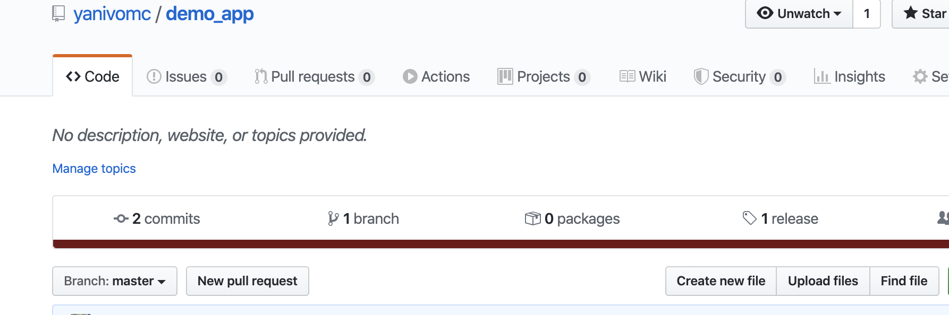
GIT TAGGING
SHARING TAGS
By default, the git push command doesn’t transfer tags to remote servers. You will have to explicitly push tags to a shared server after you have created them. This process is just like sharing remote branches — you can run git push origin <tagname>
Push your tags to your repository and then make sure it’s available in your github repo

Slide 29
GIT TAGGING
SHARING TAGS
If you have a lot of tags that you want to push up at once, you can also use the --tags option to the git push command. This will transfer all of your tags to the remote server that are not already there.
Now, when someone else clones or pulls from your repository, they will get all your tags as well

Slide 30
GIT TAGGING
DELETING TAGS
Use git tag -d [tag]

Slide 31
- GIT ALIASES -

Slide 32
GIT ALIASES
LAST SUBJECT BEFORE WE DIVE IN TO ADVANCED GIT
If we don’t want to type the entire text of each of the Git commands, we can easily set up an alias for each command using git config. Here are a couple of examples each one of you may want to set up
# Setting up aliases
$ git config --global alias.co checkout
$ git config --global alias.br branch
$ git config --global alias.ci commit
$ git config --global alias.st status
-----
$ git ci > will run git commit
$ git st > will run git status
etc...

Slide 33
- GIT BRANCHING -
LET THE GOOD TIMES ROLLES

Slide 34
GIT BRANCHING
Now that we finished all the basic stuff in git,
It’s time to move forward to the reason GIT is such a powerful tool for source code collaboration
Nearly every VCS has some form of branching support. Branching means you diverge from the main line of development and continue to do work without messing with that main line. In many VCS tools, this is a somewhat expensive process, often requiring you to create a new copy of your source code directory, which can take a long time for large projects

Slide 35
GIT BRANCHING
Some people refer to Git’s branching model as its “killer feature,” and it certainly sets Git apart in the VCS community.
Why is it so special?
The way Git branches is incredibly lightweight, making branching operations nearly instantaneous, and switching back and forth between branches generally just as fast.
Unlike many other VCSs, Git encourages workflows that branch and merge often, even multiple times in a day. Understanding and mastering this feature gives us a powerful and unique tool and can entirely change the way that you develop.

Slide 36
- GIT BRANCHING -
IN A NUTSHELL

Slide 37
GIT BRANCHING
How Git Branching works?
When we make a commit, Git stores a commit object that contains a pointer to the snapshot of the content we staged. This object also contains the author’s name and email address, the message that we typed, and pointers to the commit or commits that directly came before this commit (its parent or parents): zero parents for the initial commit, one parent for a normal commit, and multiple parents for a commit that results from a merge of two or more branches.

Slide 38
GIT BRANCHING
To visualize this
let’s assume that we have a directory containing three files, and we stage them all and commit. Staging the files computes a checksum for each one (the SHA-1 hash we mentioned in Getting Started), stores that version of the file in the Git repository (Git refers to them as blobs), and adds that checksum to the staging area.

Slide 39
GIT BRANCHING
When we create the commit by running git commit, Git checksums each subdirectory (in this case, just the root project directory) and stores them as a tree object in the Git repository. Git then creates a commit object that has the metadata and a pointer to the root project tree so it can re-create that snapshot when needed.
Our Git repository now contains five objects: three blobs (each representing the contents of one of the three files), one tree that lists the contents of the directory and specifies which file names are stored as which blobs, and one commit with the pointer to that root tree and all the commit metadata.

Slide 40
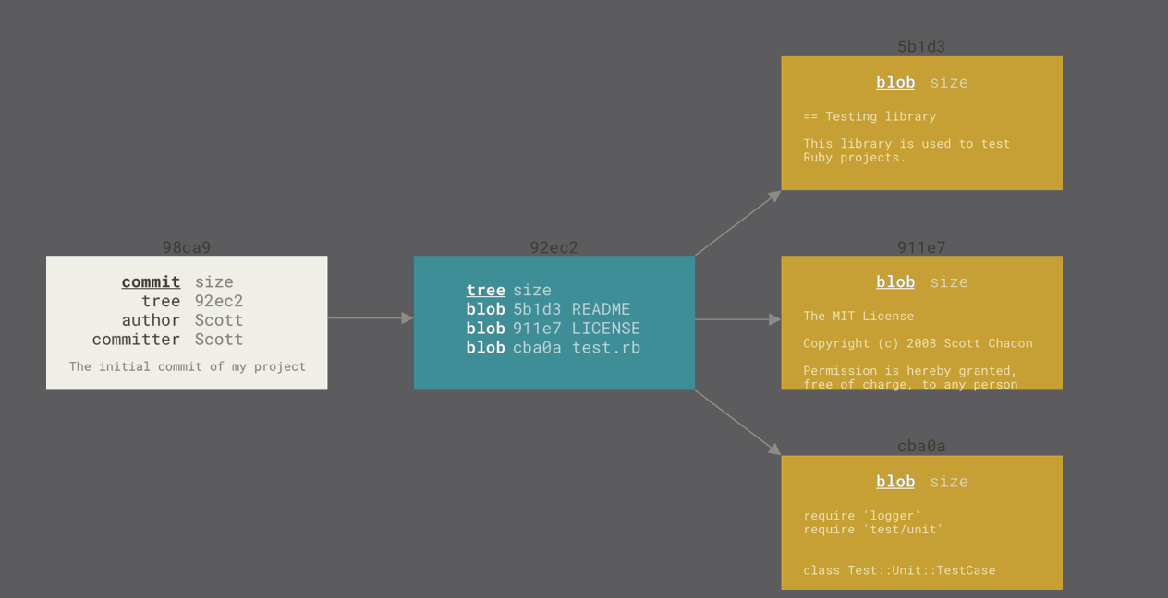
GIT BRANCHING
If we make some changes and commit again, the next commit stores a pointer to the commit that came immediately before it.

Slide 41
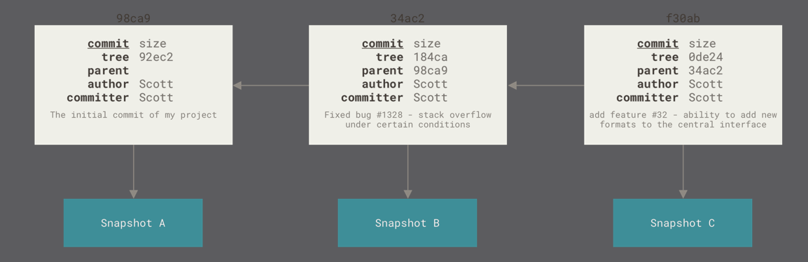
GIT BRANCHING

Slide 42
GIT BRANCHING
So what is Branching?
A branch in Git is simply a lightweight movable pointer to one of these commits.
The default branch name in Git is master. As you start making commits, you’re given a master branch that points to the last commit you made. Every time you commit, the master branch pointer moves forward automatically

Slide 43
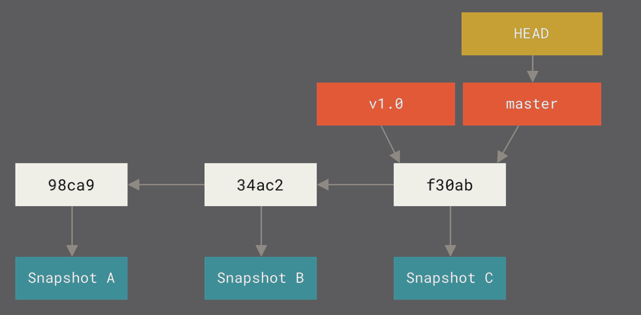
GIT BRANCHING

Slide 44
- GIT BRANCHING -
CREATING A NEW BRANCH

Slide 45
GIT BRANCHING - CRATING A NEW BRANCH
What happens when WE create a new branch?
Well, doing so creates a new pointer for us to move around.
Let’s say we want to create a new branch called testing.
we do this with the git branch command:
This creates a new pointer to the same commit we’re currently on.
git branch testing

Slide 46
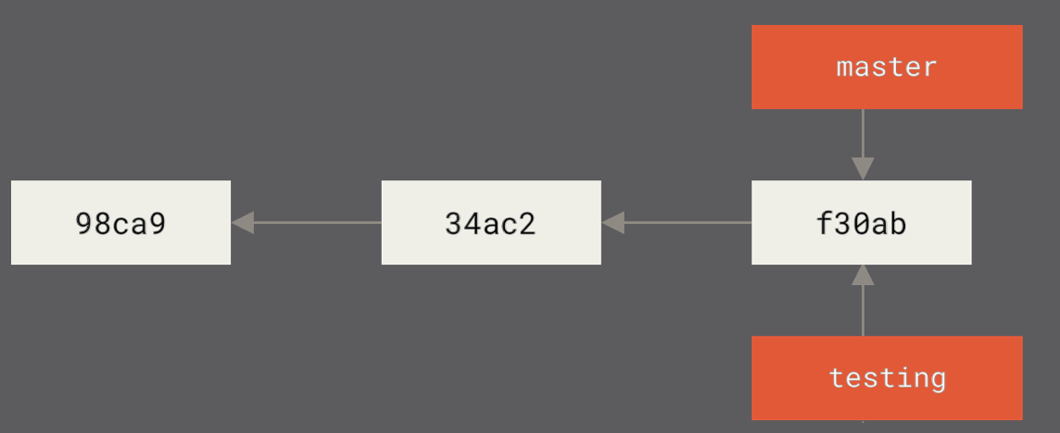
GIT BRANCHING - CRATING A NEW BRANCH

Slide 47
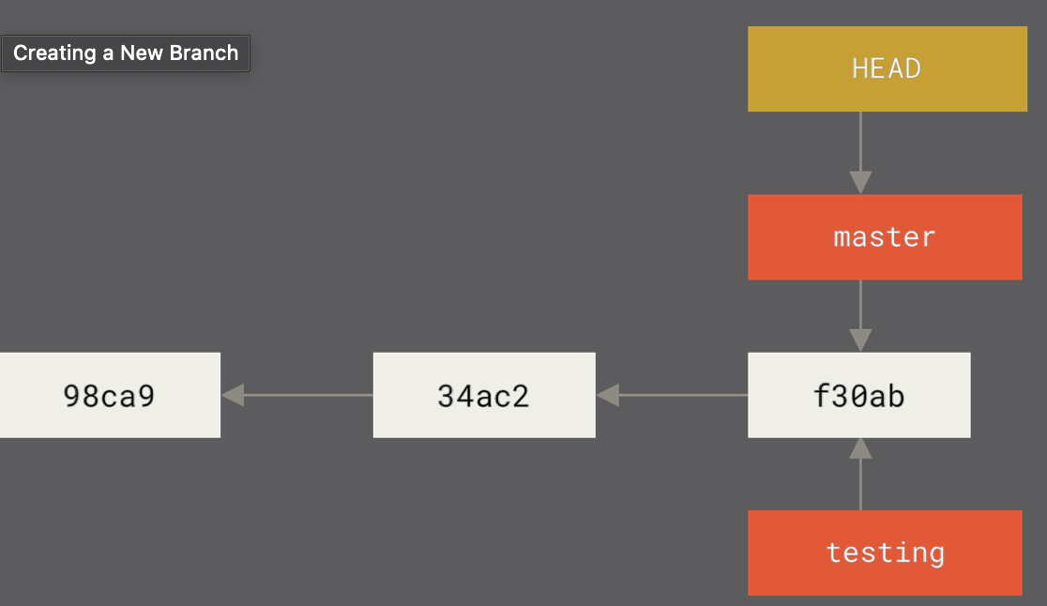
GIT BRANCHING - CRATING A NEW BRANCH
How does Git know what branch you’re currently on? It keeps a special pointer called HEAD. Note that this is a lot different than the concept of HEAD in other VCSs one may be used to, such as Subversion or CVS. In Git, this is a pointer to the local branch one currently on. In this case, we’re still on master. The git branch command only created a new branch — it didn’t switch to that branch.

Slide 48
GIT BRANCHING - CRATING A NEW BRANCH
You can easily see this by running a simple git log command that shows you where the branch pointers are pointing. This option is called --decorate
$ git log --oneline --decorate
f30ab (HEAD -> master, testing) Add feature #32 - ability to add new formats to the central interface
34ac2 Fix bug #1328 - stack overflow under certain conditions
98ca9 Initial commit

Slide 49
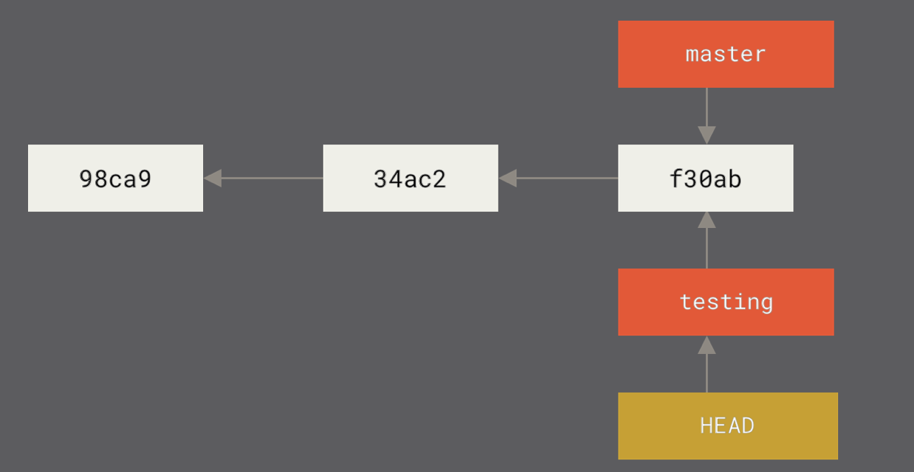
GIT BRANCHING - CRATING A NEW BRANCH
Switching Branches
$ git checkout testing
This moves HEAD from the master to point the testing branch.

Slide 50
GIT BRANCHING - CRATING A NEW BRANCH
What will happen if we commit some changes in our Testing branch and then fall back to our master Branch and commit there some other changes?

Slide 51
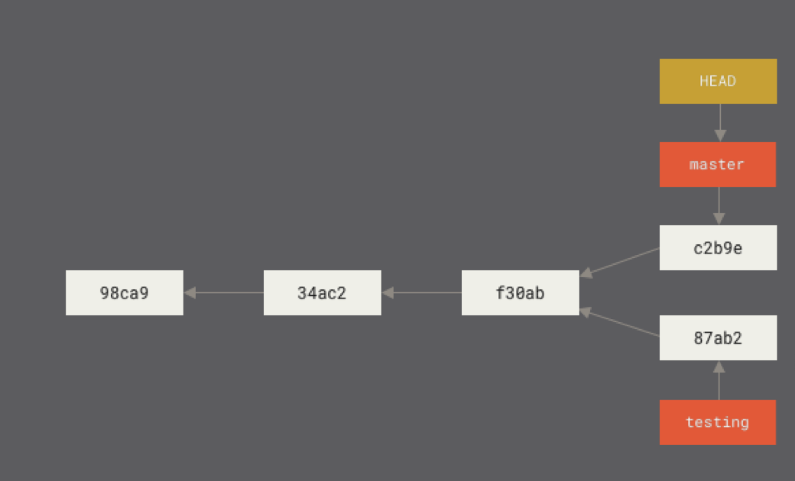
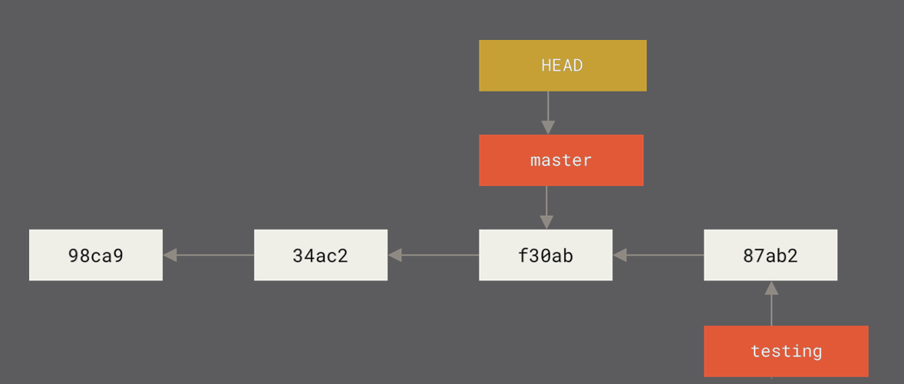
GIT BRANCHING - CRATING A NEW BRANCH

Slide 52
- GIT BRANCHING -
BASIC BRANCHING AND MERGING

Slide 53
GIT BRANCHING - BASIC BRANCHING
Let’s go through a simple example of branching and merging with a workflow that you all might use in the real world. You’ll follow these steps
Do some work on a website.
Create a branch for a new user story you’re working on.
Do some work in that branch.

Slide 54
GIT BRANCHING - BASIC BRANCHING
At this stage, you’ll receive a call that another issue is critical and you need a hotfix. You’ll do the following:
Switch to your production branch.
Create a branch to add the hotfix.
After it’s tested, merge the hotfix branch, and push to production.
Switch back to your original user story and continue working.
Questions?

Slide 55
GIT BRANCHING - BASIC BRANCHING
Let’s start:
First, let’s say we’re working on our project and have a couple of commits already on the master branch.
we’ve decided that we’re going to work on issue #53 in whatever issue-tracking system our company uses.
To create a new branch and switch to it at the same time, we can run the git checkout command with the -b switch:”

Slide 56
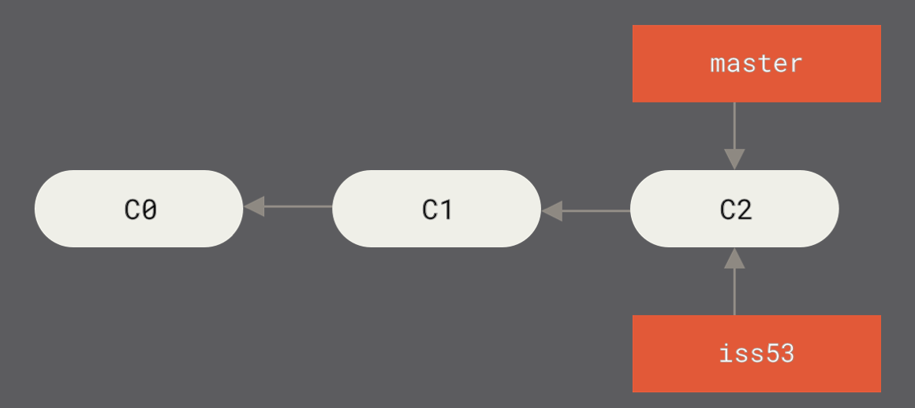
GIT BRANCHING - BASIC BRANCHING
# Switching Branch
$ git checkout -b iss53
Switched to a new branch "iss53”
# This is a shortcut for:
$ git branch iss53
$ git checkout iss53

Slide 57
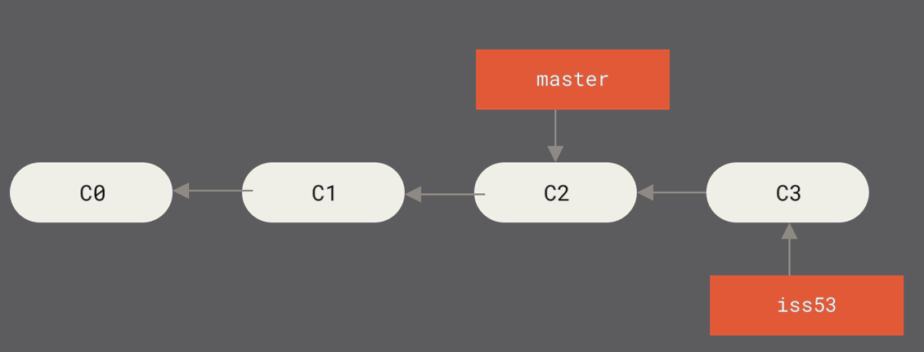
GIT BRANCHING - BASIC BRANCHING
# Now we work on our iss53 branch and doing a new commit
$ vim somefile
$ git commit -a -m “Create new footer [issue 53]”

Slide 58
GIT BRANCHING - BASIC BRANCHING
# Critical BUG! # We got an update that our clients seeing a bug in the production version we deployed from the master. # A hotfix needs to be delivered but we should not do it from our issue53 branch… # What will you do?

Slide 59
GIT BRANCHING - BASIC BRANCHING
LAB-02
Create a two files in your repo
Index.html
footer.css
Type some text inside of them
Commit and push the files to your master branch
Create a branch from your master named: iss53 and switch to it
Add a third file and update index.html
improved.css
Add text to index.html

Slide 60
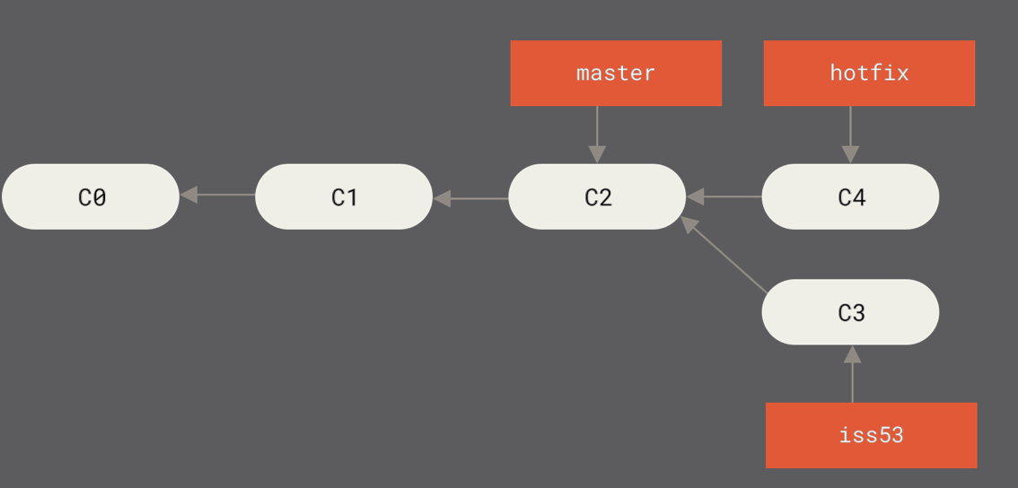
GIT BRANCHING - BASIC BRANCHING
LAB-02 continue
Create a hotfix branch from master and switch to it
Why can you create the branch? (Fix it)
Update footer.css and write inside of it - hotfix fixed
Commit and push it with a message: “Fix broken email address”
Expected result:

Slide 61
GIT BRANCHING - BASIC BRANCHING
LAB-02 continue:
Now that we got our hotfix ready and validated. We need to merge it back to our master Branch as that’s the branch that we deploy our code to production from.
Simple merge command is:
git merge [source branch]
Make sure your source branch is HOTFIX and that you are on MASTER when you run the above command.
If all goes well expected result is ->

Slide 62
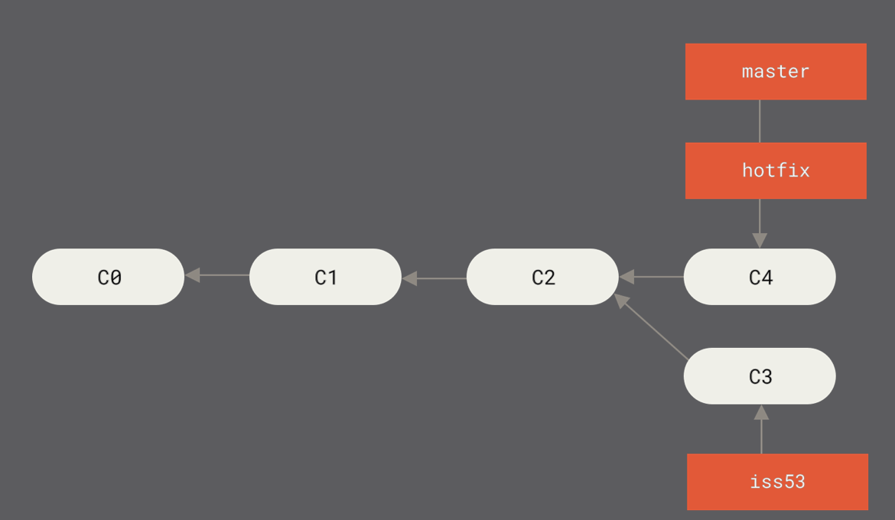
GIT BRANCHING - BASIC BRANCHING

Slide 63
GIT BRANCHING - BASIC BRANCHING
LAB-02 continue:
Push the merged MASTER to your remote origin
Validate that the merged data is in your remote repo
Delete your hotfix branch (DON’T DO THIS UNTIL I TELL YOU)
git branch -d hotfix
Switch back to your iss53 branch and update index.html as followed:
Add some text to index.html also
Commit and push with the following comment: “Finish the new footer [issue 53]”

Slide 64
GIT BRANCHING - BASIC BRANCHING
LAB-02 continue:
Merge your iss53 to master but note that this time the output on the merge is a bit different
# Merge iss53 to master output
$ git merge iss53
Merge made by the 'recursive' strategy.
index.html | 1 +
1 file changed, 1 insertion(+)
In this case, our development history has diverged from some older point. Because the commit on the branch you’re on isn’t a direct ancestor of the branch you’re merging in, Git has to do some work. In this case, Git does a simple three-way merge, using the two snapshots pointed to by the branch tips and the common ancestor of the two ---->

Slide 65
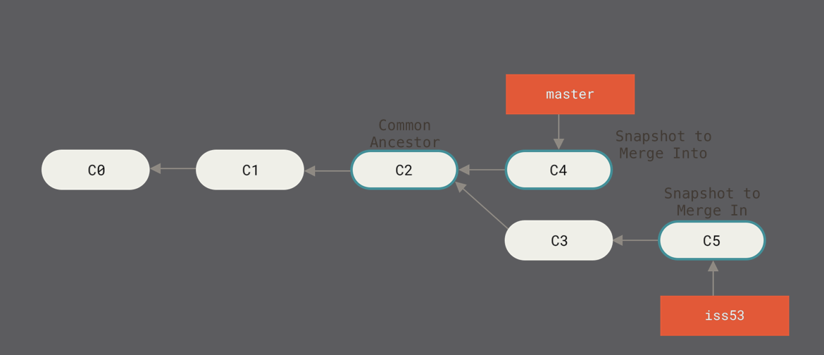
GIT BRANCHING - BASIC BRANCHING
Instead of just moving the branch pointer forward, Git creates a new snapshot that results from this three-way merge and automatically creates a new commit that points to it. This is referred to as a merge commit, and is special in that it has more than one parent

Slide 66
- GIT BRANCHING -
Basic Merge Conflicts

Slide 67
GIT BRANCHING - Basic Merge Conflicts
Occasionally, the process of merging doesn’t go smoothly. If we changed the same part of the same file differently in the two branches you’re merging, Git won’t be able to merge them cleanly. If your fix for issue #53 modified the same part of a file as the hotfix branch, you’ll get a merge conflict that looks something like this:
# Merge iss53 conflict
$ git merge iss53
Auto-merging index.html
CONFLICT (content): Merge conflict in index.html
Automatic merge failed; fix conflicts and then commit the result.
Git hasn’t automatically created a new merge commit. It has paused the process while we resolve the conflict. If we want to see which files are unmerged at any point after a merge conflict, we can run git status

Slide 68
GIT BRANCHING - Basic Merge Conflicts
$ git status
On branch master
You have unmerged paths.
(fix conflicts and run "git commit")
Unmerged paths:
(use "git add <file>..." to mark resolution)
both modified: index.html
no changes added to commit (use "git add" and/or "git commit -a")

Slide 69
GIT BRANCHING - Basic Merge Conflicts
Git adds standard conflict-resolution markers to the files that have conflicts, so you can open them manually and resolve those conflicts. Your file contains a section that looks something like this:
<<<<<<< HEAD:index.html
<div id="footer">contact : email.support@github.com</div>
=======
<div id="footer">
please contact us at support@github.com
</div>
>>>>>>> iss53:index.html
This means the version in HEAD (our master branch, because that was what we had checked out when we ran your merge command) is the top part of that block (everything above the =======), while the version in our iss53 branch looks like everything in the bottom part. In order to resolve the conflict, we have to either choose one side or the other or merge the contents yourself

Slide 70
GIT BRANCHING - Basic Merge Conflicts
For instance, we might resolve this conflict by replacing the entire block with this:
<div id="footer">
please contact us at email.support@github.com
</div>
This resolution has a little of each section, and the <<<<<<<, =======, and >>>>>>> lines have been completely removed. After you’ve resolved each of these sections in each conflicted file, run git add on each file to mark it as resolved. Staging the file marks it as resolved in Git.

Slide 71
GIT BRANCHING - Basic Merge Conflicts
Git merge conflict resolve with a graphical tool
If you want to use a graphical tool to resolve these issues, you can run git mergetool, which fires up an appropriate visual merge tool and walks you through the conflicts.
But for now… leave it as is.
We will discuss this later.

Slide 72
- GIT BRANCHING -
BRANCH MANAGEMENT

Slide 73
GIT BRANCHING - Branch Management
GIT MANAGEMENT COMMANDS
# COMMANDS
$ git branch >>> Shows branch list and on which branch we are
$ git branch -v >>> Shows last commit on each branch
$ git branch >> --merged and --no-merged options can filter this list to branches that you have or have not yet merged into

Slide 74
- GIT BRANCHING -
BRANCHING WORKFLOWS

Slide 75
GIT BRANCHING - BRANCHING WORKFLOW
Now that you have the basics of branching and merging down, what can or should you do with them? In this section, we’ll cover some common workflows that this lightweight branching makes possible, so you can decide if you would like to incorporate them into your own development cycle.

Slide 76
GIT BRANCHING - BRANCHING WORKFLOW
Long-Running Branches
Because Git uses a simple three-way merge, merging from one branch into another multiple times over a long period is generally easy to do. This means you can have several branches that are always open and that you use for different stages of your development cycle; you can merge regularly from some of them into others.

Slide 77
GIT BRANCHING - BRANCHING WORKFLOW
Many Git developers have a workflow that embraces this approach
such as:
Having only code that is entirely stable in their master branch - Possibly only code that has been or will be released.
Another parallel branch named develop or next that they work from or use to test stability — it isn’t necessarily always stable, but whenever it gets to a stable state, it can be merged into master. It’s used to pull in topic branches (short-lived branches, like your earlier iss53 branch) when they’re ready, to make sure they pass all the tests and don’t introduce bugs.
Topic / Feature as our iss53 branch we created.

Slide 78
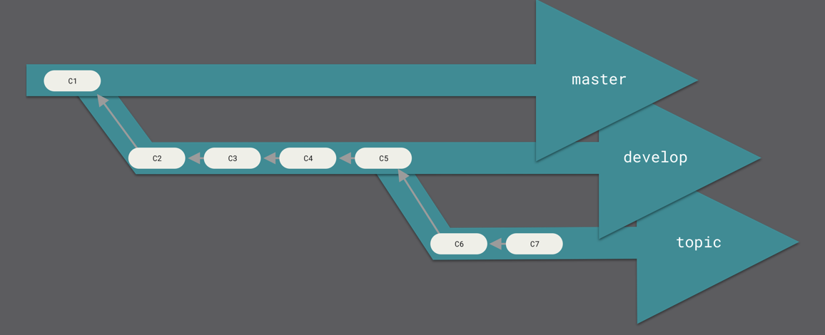
GIT BRANCHING - BRANCHING WORKFLOW

Slide 79
GIT BRANCHING - BRANCHING WORKFLOW
Topic / Feature Branches
Topic branches, however, are useful in projects of any size.
A topic branch is a short-lived branch that we create and use for a single particular feature or related work.
This is something we’ve likely never done with a VCS before because it’s generally too expensive to create and merge branches. But in Git it’s common to create, work on, merge, and delete branches several times a day

Slide 80
- GIT BRANCHING -
REBASING

Slide 81
GIT BRANCHING - REBASING
In Git, there are two main ways to integrate changes from one branch into another:
the merge
the rebase.
In this section you’ll learn what rebasing is, how to do it, why it’s a pretty amazing tool, and in what cases you won’t want to use it.

Slide 82
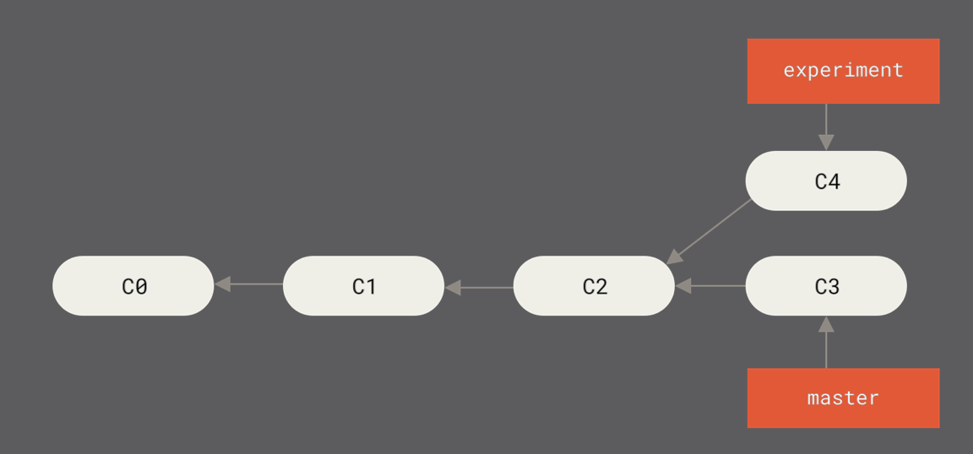
GIT BRANCHING - REBASING
The Basic Rebase
If you recall an earlier example from Basic Merging, we can see that we diverged our work and made commits on two different branches.
The easiest way to integrate the branches, as we’ve already covered, is the merge command. It performs a three-way merge between the two latest branch snapshots (C3 and C4) and the most recent common ancestor of the two (C2), creating a new snapshot (and commit).

Slide 83
GIT BRANCHING - REBASING
The Basic Rebase
If you recall an earlier example from Basic Merging, we can see that we diverged our work and made commits on two different branches.

Slide 84
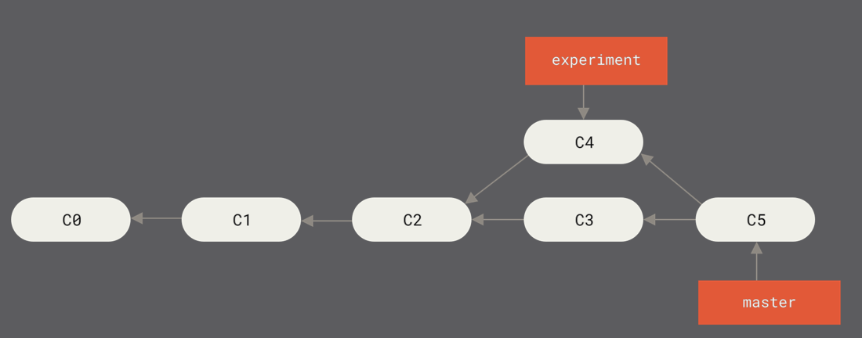
GIT BRANCHING - REBASING
The easiest way to integrate the branches, as we’ve already covered, is the merge command. It performs a three-way merge between the two latest branch snapshots (C3 and C4) and the most recent common ancestor of the two (C2), creating a new snapshot (and commit).

Slide 85
GIT BRANCHING - REBASING
However, there is another way: we can take the patch of the change that was introduced in C4 and reapply it on top of C3. In Git, this is called rebasing. With the rebase command, we can take all the changes that were committed on one branch and replay them on a different branch

Slide 86
GIT BRANCHING - REBASING
REBASE LAB 01:
Create a new branch in your repo called “experiment” and switch to him
In the experiment branch add multiple files of your decision and paste some information in them
Stage the files and commit them with the content “crazy-ideas [exp]”
Push the changes to Remote.
Let’s rebase master
In your experiment branch run:
# REBASE
$ git rebase master (make sure you are in the “experiment” branch first”
First, rewinding head to replay your work on top of it...
Applying: added staged command

Slide 87
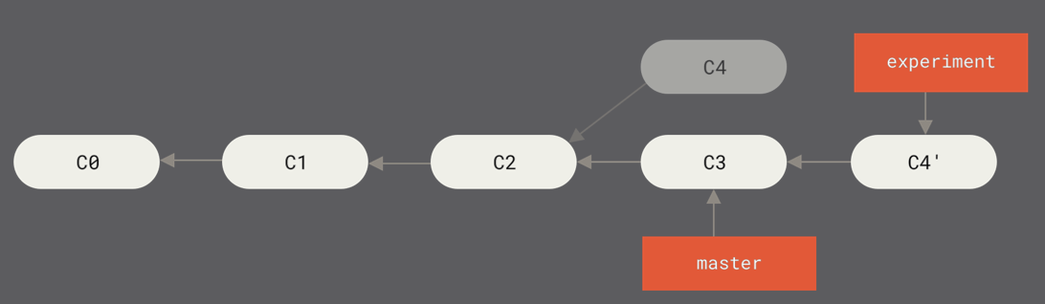
GIT BRANCHING - REBASING
This operation works by going to the common ancestor of the two branches (the one you’re on and the one you’re rebasing onto), getting the diff introduced by each commit of the branch you’re on, saving those diffs to temporary files, resetting the current branch to the same commit as the branch you are rebasing onto, and finally applying each change in turn.

Slide 88
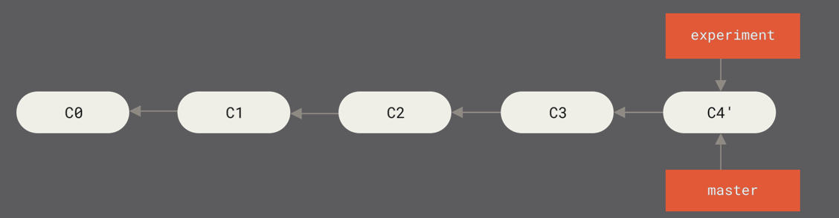
GIT BRANCHING - REBASING
At this point, we can go back to the master branch and do a fast-forward merge.
# REBASE
$ git checkout master
$ git merge experiment

Slide 89
GIT BRANCHING - REBASING
Often, we’ll do this to make sure our commits apply cleanly on a remote branch — perhaps in a project to which we’re trying to contribute but that we don’t maintain.
In this case, we’d do our work in a branch and then rebase our work onto origin/master when we are ready to submit our patches to the main project.
That way, the maintainer doesn’t have to do any integration work — just a fast-forward or a clean apply.

Slide 90
GIT BRANCHING - REBASING
REBASE OR MERGE?
In general the way to get the best of both worlds is to rebase local changes you’ve made but haven’t shared yet before you push them in order to clean up your story, but never rebase anything you’ve pushed somewhere.

Slide 91
- NEXT -
IN OUR NEXT SESSION

Slide 92
WHAT’S NEXT?
In our next session we will discuss GITHUB in details,
Talk about software lifecycle and how to manage our repo.
We’ll talk about code review and forks in github along with Sharing and PIPELINES.

Slide 93
DOCKER LAB CONTINUE
Please push the docker lab code you are working on to your github account and send the URL’S to us once you complete your homework.
Make sure to create a master branch and all of your ongoing development should be in DEVELOPMENT branch.
Once you complete and have something for us to test.
Please tag it and send it to us.

Slide 94
GIT OPERATION PART II -
END
LINK FOR OUR SLIDE DECK
https://bit.ly/git-2020-part2-devopshift

